Slide 1
DATA-225 Sec11-Db Systems for Analytics
Significant Paper Presentation
Group 7:
Bhakti Raichura
Khushee Thakker
Shreya Srirama
Varsha Srinivasan

Slide 2

Identify the brand and it’s USP

Slide 3
Details of Significant Paper
Big Data Analytics for Electric Vehicle Integration in Green Smart Cities
Paper URL: https://ieeexplore-ieee-org.libaccess.sjlibrary.org/document/8114543
Authors: Boyang Li; Mithat C. Kisacikoglu; Chen Liu; Navjot Singh; Melike Erol-Kantarci
Citations: 41

Slide 4
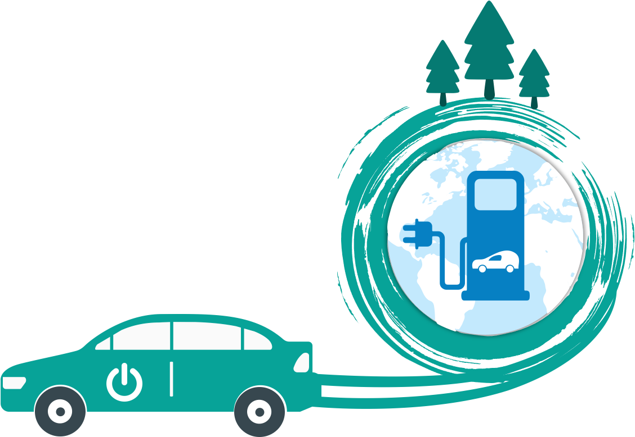
Contents
1
Abstract and Overview
2
Motivation
3
Methodology
4
Analytics
5
Key Learnings
6
Future Scope and Conclusion

Slide 5
Abstract
All about Electric Vehicles
What
Why
How
EVs play an important role in helping the smart cities become greener by reducing the carbon emissions. EVs generate a lot of data which can be vehicle data, driver, charging station, or even smart city related such as traffic condition on roads
Limited driving range and associated driver range anxiety, long duration for charging, and non-ubiquity of charging stations are the critical barriers to the penetration of EVs. The charging data being generated is rapidly increasing too creating a big data problem
Handle big data for siting electric charge stations, developing smart charging solutions and determine vehicle to grid opportunities using tools and techniques like Hadoop framework, NoSQL HBase, Map Reduce algorithms

Slide 6

Motivation
The EV industry is valued at 370.86B
$$$
Smart city of future will be dominated by EVs
Value
Scope
New Avenues
to reduce CO2
Environment
Improved health benefits for riding e-bikes
Health
EVs require
minimal care
Maintenance
Sensors help collect data for travel patterns
Data

Slide 7
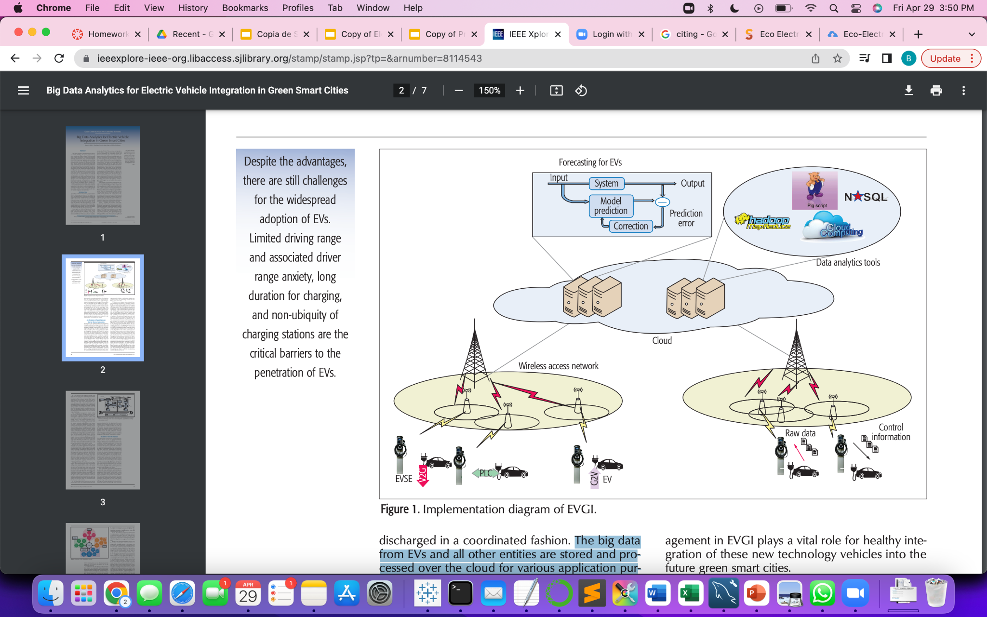
Methodology
Smart grid is the modernized electrical grid that integrates advanced sensing
The big data from EVs and all other entities are stored and processed over the cloud using tools like Hadoop, Pig script (NoSQL) for various application purposes including optimized charging
There is a prediction and correlation model used to anticipate the charging requirements. This helps EV companies or private plates install charging stations accordingly

Slide 8
Big Data Analytics Platforms and EV Integration
Hadoop-Based Approaches
Optimized Charging
Battery Consumption Prediction
Charging Meter Management
EV Status Tracking

Slide 9
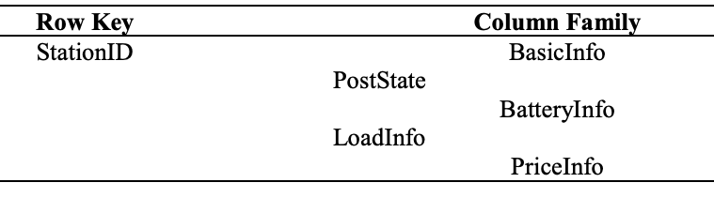



Optimized Charging
EV battery
data
User data
Structure of Calculation Basic Data Table
Data
Source
HBase
Charging
station data
Grid demand data
Structure of Charge Request and Event Table
key1: stationID; eventID
value1: tCharge; tWait; tOut
key2: stationID value2: eventID; Priority
key2:stationID value: List<List< Priority>>
MAP
Reduce
Notes:
Chose HBase - non relational and scalability
Chose MapReduce hadoop framework - to handle the large amount of data from multiple sources, processing data in parallel
Map - Model uses Map to compute the priority of each task
Reduce- to merge and sort priority and divide the tasks into multiple queues

Slide 10
Battery Consumption Prediction
Long/Latitude
Slope
Temperature
Filtering, Sampling
Sophisticated time series analysis
SoC
State of
Charge stream
Hadoop
Pig script
R Package
Prediction model
Velocity
Outliers, Average…
Neural network….
Humidity
TimeStamp
Air Pressure
Notes:
The state of charge (SOC) is a measurement of the amount of energy available in a battery at a specific point in time expressed as a percentage i.e. ratio of the available capacity and the maximum possible charge that can be stored in a battery
R package to conduct time series analysis and provided prediction of EVs’ battery consumption.
A time-combined model reduces the fitting error by 50 %, compared with the distance-only model.

Slide 11

Charging Meter Management
Master Data Management Software (MDMS)
Authorized access
user | cnt
Hadoop
charger | cnt
daysofweek | cnt
….
RMySQL
ODBC
R
FANN

Slide 12
EV Status Tracking
ImportTSV
Output File
HBase
JAVA API
CSV
Application
CompleteBulkLoad
Read
write
HDFS
Tableau

Slide 13
Key Learnings
Cloud limitations
Future of Automobile: EVs
Delay for accessing the cloud is a major concern for real-time applications. Mobile edge computing using Hadoop-like parallelization can reduce the response time of decision making
Owning an electric vehicle will be absolutely necessary in future smart cities and thus data analysis will play a key role in optimizing the big data generated by these EVs
Learnings
Data Security
Balance between consumers’ privacy and the benefit of sharing data needs to be maintained. The nexus of security and privacy are open issues that are yet to be addressed in the domain of big data analytics for EVs.
Latency in using HBase
Hbase when used in combination with Map-Reduce and Hive jobs is memory intensive and cause latencies. The same analysis can be explored using Cassandra or MongoDB

Slide 14
Future Scope
Data Privacy
Graph DB for route analysis for charge stations
Data prediction
Security and privacy concerns escalate with distributed processing of EV data by other EVs
Graph Databases can be used to explore the map routes for finding closest charge stations
Through data mining and machine learning tools, we can predict the demand in EVs and charging needs

Slide 15
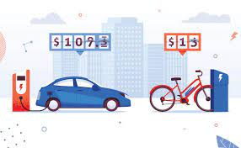
Conclusion
The big data analysis done in this paper on installing charging stations for efficient use can be extended in our project on bike sharing
Promote the use of Electric Vehicles including E-bikes to get ready for the future of smart cities
Extend the EV model to “shared EV” model
Determine other external factors influencing the demand for EVs like weather, trip details etc.

Slide 16
Appendix
Rubric Criteria | Slide Reference
Key Learnings- Students summarized what they learned and the learnings are substantial | Database and Big data concepts covered Slide Number Reference: 14
Topic and contents of the paper Are the contents relevant and significant to the course work? | Yes, CLOs achieved Slide Number Reference: 7,10,11,12
Source of the Significant Paper Is it from a reputed journal or conference? | Yes, IEEE Slide Number Reference: 3
Relation to Project Did the project build upon the significant paper? | Yes, Our project talks about how external factors influence e-bike sharing patterns

Slide 17
THANK YOU!
DO YOU HAVE ANY QUESTIONS?

